Slide 1


CHAT ROOM APPLICATION USING SOCKET.IO
REVIEW -1 Computer Networks Project

Slide 2


Team Members
KAUSTUBH GUPTA (RA2011003010476)
PRATEEK (RA2011003010491)
AYUSH ABHIGYAN (RA2011003010493)
AFRAZ TANVIR (RA2011003010499)
SOHAM GHOSH (RA2011003010504)

Slide 3
Contents
PROJECT DEFINITION
ABTSRACT
PROJECT SCOPE
RELATION TO EXTERNAL ENVIRONMENT
LANGUAGES AND TOOLS USED
DESIGN CONSIDERATION
METHODOLOGY
FLOW CHART

Slide 4
Project Definition
To make a chat room application where users can make their own room functionality where users share the room with their friends to have text based communication.

Slide 5
ABSTRACT
We will use Node.js for the backend which will create rooms and handle the backend part of our application. Additionally we will use socket.io to enable real time communication between Client and server. Teleconferencing or Chatting, is a method of using technology to bring people and ideas “together” despite of the geographical barriers. The technology has been available for years but the acceptance it was quite recent. Our project is an example of a chat server. We created a real-time chat application with room functionality where you can create your own room and share the room name with your friends to have text-based communication.

Slide 6
Project Scope
Teleconferencing or Chatting, is a method of using technology to bring people and ideas “together” despite of the geographical barriers. The technology has been available for years but the acceptance it was quite recent. Our project is an example of a chat server. We created a real-time chat application with room functionality where you can create your own room and share the room name with your friends to have text-based communication.

Slide 7
Relation to External Environment
This tool helps in too major aspects-
List of the names of online users in the Room.
Used for communication between multiple systems enlisted in the list

Slide 8







Languages and Tools Used

Slide 9
Design Consideration
We will be using Node.js for the back end, which will be responsible for creating rooms and managing users in those rooms. Additionally, we will be using Socket.io to enable real-time, bidirectional communication between the web server and the client (browser).

Slide 10
Methodology
The user will interact with the tool using a GUI
The user enters a username and a room name
A room is created and it has a list form and a chat form
The list form contains the usernames of the people in the room
The chat form makes the actual communication possible in the form of text

Slide 11
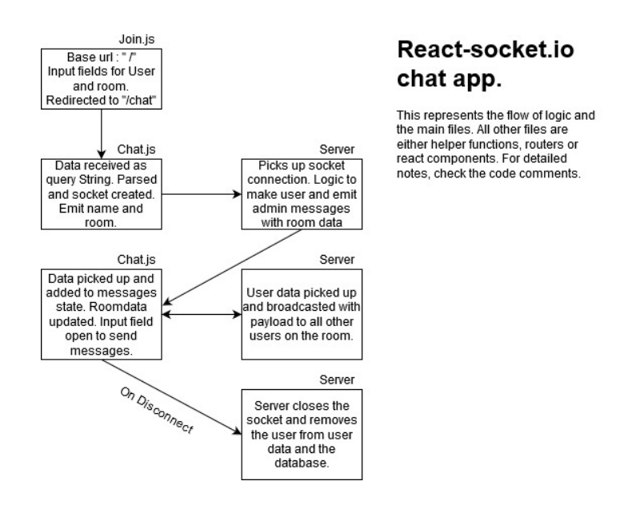
Flow Chart

Slide 12
Thank You
KAUSTUBH GUPTA (RA2011003010476)
PRATEEK (RA2011003010491)
AYUSH ABHIGYAN (RA2011003010493)
AFRAZ TANVIR (RA2011003010499)
SOHAM GHOSH (RA2011003010504)

